Slide 1
Data Structures

Slide 2
Agenda
Intersection point in Y shaped LL
Detect Loop
Remove Loop

Slide 3
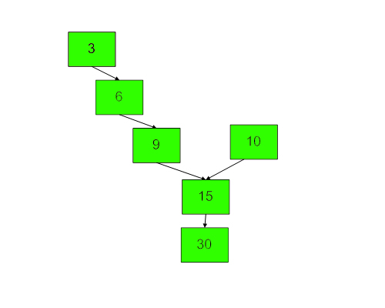
Intersection point in Y shaped LL

Slide 4
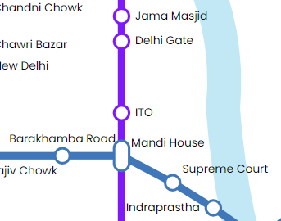
Intersection point in Y shaped LL

Slide 5
Intersection point in Y shaped LL

Slide 6
Detect Loop

Slide 7
Remove Loop – Don’t do this

Slide 8
Remove Loop – Approach 1
void removeLoopApproach1(Node listNode, Node loopNode) {
Node temp = loopNode;
while (true) // to move listNode
{
while (listNode.next != loopNode.next && loopNode.next != temp)// to move loopNode
{
loopNode = loopNode.next;
}
// it could have broken due to 2 reason
if (listNode.next == loopNode.next) {
loopNode.next = null;
return;
}
listNode = listNode.next;
}
}

Slide 9
Remove Loop - Approach 2

Slide 10
Remove Loop - Approach 3

Slide 11
Remove Loop - Approach 3
When(s==f) Take slow to head and move them together

Slide 12
Remove Loop - Approach 3 -> Circular LL

Slide 13
THANK YOU

